Slide 1
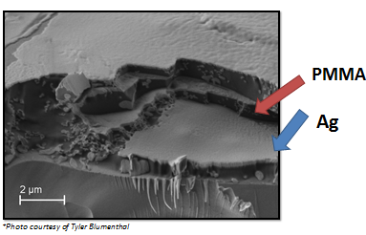
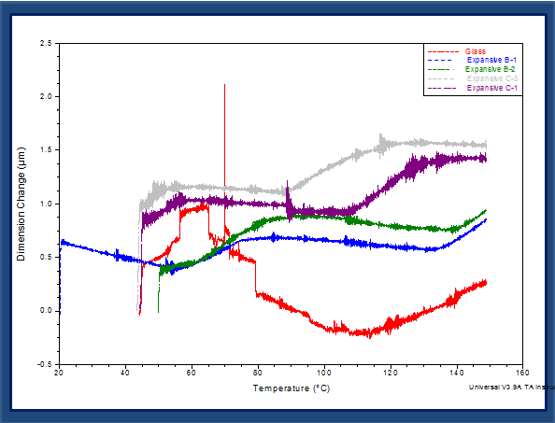
Direct Write Printed Capacitors Utilizing the Polymer PMMA and Silver Nanoparticles
Research Undergraduate: Angelica Moore (SDSMT)
Advisors: Drs. William Cross and Thomas Montoya
Research Objectives
Determine the glass transition temperature of a 2-D PMMA layer
Discern how heating PMMA above the glass transition temperature affects the dielectric constant
Discover how to create a conductive silver layer through composition and sintering
Form a capacitor with optimal properties including dielectric constant
Introduction
Direct write technology has existed in myriad forms since its inception in the early 1990's for military purposes; one of its applications especially of late consists of the creation of flexible and more cost effective electronics from simple transistors to complete circuits(8). This study aims to investigate whether printed silver nanoparticles and the polar polymer PMMA (poly methyl methacrylate) can form an efficient direct-write synthesized capacitor.
Future Work
Cap Ag particles in elaidic acid, filter them, and make them square
Add a larger weight percent of Ag particles
Cure Ag particles for a longer time.
Find a way to measure the dielectric constant
Change the ratio of methyl benzoate to toluene from 1:9 to 1.5:9
Measure the dielectric constant of PMMA
Form a capacitor
Procedure
Mix and spray a PMMA mixture on a glass slide with a SonoTek direct write printer
Use a TMA machine to find the glass transition temperature of PMMA
Sinter and test for conductivity in silver slides
Mix and spray a 1.5% silver solution using a SonoTek direct write printer
Heat silver in a furnace to form a conductive layer
Results
Conclusions
The glass transition temperature increases slightly in a 2-D state
Glass transition temperature was slightly higher when the flow rate of PMMA was increased
Conductivity was not achieved at when sintered at 150 degrees.
Capacitors
K = dielectric constant
C = capacitance
Acknowledgments
Thanks to the National Science Foundation grant #0852057, Dr. William Cross, Dr. Thomas Montoya, and Dr. Alfred Boysen, Tyler Blumenthal, Krishnamraju Ankireddy, and James Randle
*Photos courtesy of http://hyperphysics.phy-astr.gsu.edu/hbase/electric/pplate.html

